Slide 1
Lecture 14
Signals and Systems (ELL205)
By Dr. Abhishek Dixit
Dept. of Electrical Engineering
IIT Delhi

Slide 2
Towards Fourier Series

Slide 3
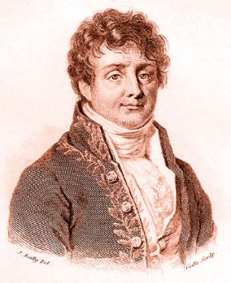
Jean Baptiste Joseph Fourier

Slide 4
Brief Biography
Jean-Baptiste Joseph Fourier (21 March 1768 – 16 May 1830) was a French mathematician and physicist born in Auxerre.
He lived during the time of French revolution and even escaped guillotine.
Fouier was an Egyptologist and accompanied Napolean Bonaparte on his Egyptian expedition.
He is buried in the Père Lachaise Cemetery in Paris.
His name is one of the 72 names inscribed on the Eiffel Tower.
Worked at École Polytechnique.
He is best known for Fourier series. Fourier Series is described by many as the most beautiful mathematical poem.

Slide 5
Criticized heavily
S. F. Lacroix
G. Monge
P. S. De Laplace
J. L. Lagrange
Further reviewed by Poisson
and Legendre

Slide 6
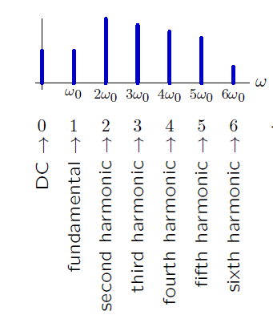
Harmonics

Slide 7
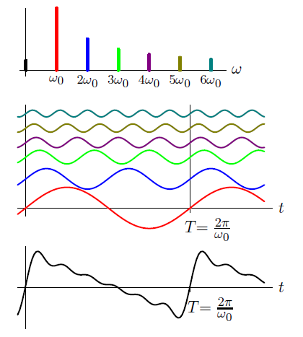
What signals can be represented by the sum of fundamentals and its harmonics?

Slide 8
Fourier Series
$$x\left(t\right)=x\left(t+T\right)=\sum_{k=−∞}^{∞}{a_{k}e^{jkω_{o}t}}$$
y$\left(t\right)=y\left(t+T\right)=\sum_{k=−∞}^{∞}{a_{k}e^{jkω_{o}t}H(kω_{o})}$
$a_{k}$ are called Fourier series spectral coefficients

Slide 9
Check it ?
If $x\left(t\right)$ is real, what is true about $a_{k}$
1)$a_{k}=\overline{a_{−k}}$ | 2)$a_{k}=\overline{a_{k}}$
3)$a_{k}=a_{−k}$ | 4)$a_{k}={−a}_{−k}$

Slide 10
Check it ?
If $x\left(t\right)$ is real, what is true about $a_{k}$
1)$a_{k}=\overline{a_{−k}}$ | 2)$a_{k}=\overline{a_{k}}$
3)$a_{k}=a_{−k}$ | 4)$a_{k}={−a}_{−k}$

Slide 11

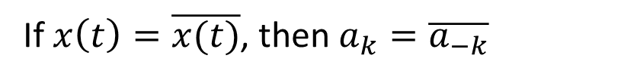
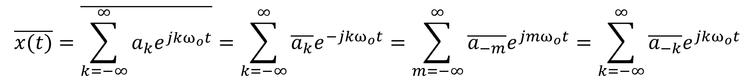
Check it ?
If $x\left(t\right)$ is real, what is true about $a_{k}$
$$x\left(t\right)=\sum_{k=−∞}^{∞}{a_{k}e^{jkω_{o}t}}$$
$$\overline{x(t)}=\overline{\sum_{k=−∞}^{∞}{a_{k}e^{jkω_{o}t}}}=\sum_{k=−∞}^{∞}{\overline{a_{k}}e^{−jkω_{o}t}}=\sum_{m=−∞}^{∞}{\overline{a_{−m}}e^{jmω_{o}t}}=\sum_{k=−∞}^{∞}{\overline{a_{−k}}e^{jkω_{o}t}}$$
If $x\left(t\right)=\overline{x(t)}$, then $a_{k}=\overline{a_{−k}}$

Slide 12
Fourier Spectral Coefficients
$$x\left(t\right)=x\left(t+T\right)=\sum_{k}{a_{k}e^{jkω_{o}t}}$$
$$e^{−jlω_{o}t}$$
Multiplying with and integrating over one time period
$$\int_{T}{x\left(t\right)e^{−jlω_{o}t}dt=\int_{T}{\sum_{k}{a_{k}e^{jkω_{o}t}}e^{−jlω_{o}t}dt}}$$
$$\int_{T}{e^{j(k−l)ω_{o}t}dt=Tδ[k−l] }$$
Changing order of integration and summation and using we get
$$ak=\frac{1}{T}\int_{T}{x\left(t\right)e^{−jkω_{o}t}dt}$$

Slide 13
Analysis and Synthesis equation
$$x\left(t\right)=x\left(t+T\right)=\sum_{k}{a_{k}e^{jkω_{o}t}}$$
Synthesis
$$ak=\frac{1}{T}\int_{T}{x\left(t\right)e^{−jkω_{o}t}dt}$$
Analysis

Slide 14
Analysis and Synthesis equation
$$x\left(t\right)=x\left(t+T\right)=\sum_{k}{a_{k}e^{jkω_{o}t}}$$
Synthesis
$$ak=\frac{1}{T}\int_{T}{x\left(t\right)e^{−jkω_{o}t}dt}$$
Analysis
$x\left(t\right)$ real implies
$$a_{k}=\overline{a_{−k}}$$
$$x\left(t\right)=a_{o}+\sum_{k=1}^{∞}{(B_{k}coskωot−C_{k}sinkωot)}$$
(Rectangular)
$$ak=B_{k}+jC_{k}$$
$$x\left(t\right)=a_{o}+\sum_{k=1}^{∞}{Akcos(kωot+θk)}$$
(Polar)
$$ak=A_{k}e^{jθ_{k}}$$

Slide 15
Question
$$x\left(t\right)=\left\{\begin{aligned}1 \left|t\right|<T1 \\ 0 T1<\left|t\right|≤T\end{aligned}\right.$$
-T₁
T₁
-T/2 0 T/2
How many of the following statements are correct?
1. $ak$ are real and even | 2. $ak$ are imaginary and odd
3. $ak$ is 0 if $k$ is even but not zero and duty cycle is 50% | 4. $ak$ decreases as $k$ increases

Slide 16
Obs. 1: Even signal has even coefficients
$$x\left(t\right)↔ak$$
$$x\left(−t\right)↔a_{−k}$$
If then
Proof:
$$x\left(t\right)=\sum_{k}{a_{k}e^{jkω_{o}t}}$$
$$x\left(−t\right)=\sum_{k}{a_{k}e^{−jkω_{o}t}}$$
$$=\sum_{k′}{a_{−k′}e^{jk′ω_{o}t}}$$
$$=\sum_{k}{a_{−k}e^{jkω_{o}t}}$$

Slide 17
Obs. 2 Real & Even together
$$x\left(t\right)↔ak$$
$$x\left(−t\right)↔a_{−k}$$
$$\overline{x\left(t\right)}↔\overline{a_{−k}}$$
If then &
Even:
$$ak=a_{−}k$$
Real:
$$ak=\overline{a_{−}k }$$
Real & Even:
$$ak=\overline{a_{−}k }=\overline{a_{k}}$$

Slide 18
Obs. 2 Real & Even together
$$x\left(t\right)↔ak$$
$$x\left(−t\right)↔a_{−k}$$
$$\overline{x\left(t\right)}↔\overline{a_{−k}}$$
If then &
Even:
$$ak=a_{−}k$$
Signal | Coefficients
Real & Even | Real & Even
Real:
$$ak=\overline{a_{−}k }$$
Real & Even:
$$ak=\overline{a_{−}k }=\overline{a_{k}}$$

Slide 19
Obs. 2 Real & Even together
$$x\left(t\right)↔ak$$
$$x\left(−t\right)↔a_{−k}$$
$$\overline{x\left(t\right)}↔\overline{a_{−k}}$$
If then &
Odd:
$$ak={−a}_{−}k$$
Signal | Coefficients
Real & Even | Real & Even
Real & Odd | Imaginary & Odd
Real:
$$ak=\overline{a_{−}k }$$
Real & Odd:
$$ak=\overline{a_{−}k }=−\overline{a_{k}}$$

Slide 20
Obs. 2 Real & Even together
$$x\left(t\right)↔ak$$
$$x\left(−t\right)↔a_{−k}$$
$$\overline{x\left(t\right)}↔\overline{a_{−k}}$$
If then &
Even:
$$ak=a_{−}k$$
Signal | Coefficients
Real & Even | Real & Even
Real & Odd | Imaginary & Odd
Imaginary & Even | Imaginary & Even
Imag.:
$$ak=−\overline{a_{−}k }$$
Imag. & Even:
$$ak=−\overline{a_{−}k }=−\overline{a_{k}}$$

Slide 21
Obs. 2 Real & Even together
$$x\left(t\right)↔ak$$
$$x\left(−t\right)↔a_{−k}$$
$$\overline{x\left(t\right)}↔\overline{a_{−k}}$$
If then &
Odd:
$$ak={−a}_{−}k$$
Signal | Coefficients
Real & Even | Real & Even
Real & Odd | Imaginary & Odd
Imaginary & Even | Imaginary & Even
Imaginary & Odd | Real & Odd
Imag.:
$$ak=−\overline{a_{−}k }$$
Imag. & Odd:
$$ak=−\overline{a_{−}k }=\overline{a_{k}}$$

Slide 22
Question
$$x\left(t\right)=\left\{\begin{aligned}1 \left|t\right|<T1 \\ 0 T1<\left|t\right|≤T\end{aligned}\right.$$
-T₁
T₁
-T/2 0 T/2
How many of the following statements are correct?
1. $ak$ are real and even  | 2. $ak$ are imaginary and odd 
3. $ak$ is 0 if $k$ is even but not zero and duty cycle is 50% | 4. $ak$ decreases as $k$ increases

Slide 23
Working out the mechanics
$$a_{k}=\frac{1}{T}\int_{−T1}^{T1}{e^{−jkω_{o}t}dt}$$
$$a_{k}=\frac{1}{−jkω_{o}T}{\left[e^{−jkω_{o}t}\right]}_{−T1 }^{T1}$$
$$a_{k}=\frac{1}{−jkω_{o}T}\left[e^{−jkω_{o}T1}−e^{jkω_{o}T1}\right]$$
$$a_{k}=\frac{1}{jkω_{o}T}\left[e^{jkω_{o}T1}−e^{−jkω_{o}T1}\right]$$

Slide 24
Working out the mechanics
$$a_{k}=\frac{1}{jkω_{o}T}\left[e^{jkω_{o}T1}−e^{−jkω_{o}T1}\right]$$
=$\frac{2}{kω_{o}T}sin⁡(kω_{o}T1)$
=$\frac{2T1}{T}\frac{sin⁡(kω_{o}T1) }{kω_{o}T1}$
=$\frac{2T1}{T}sinc(kω_{o}T1)$
where $sinc(θ)=\frac{sinθ}{θ}$
where $D=\frac{2T1}{T}$
=$Dsinc(kπD)$

Slide 25
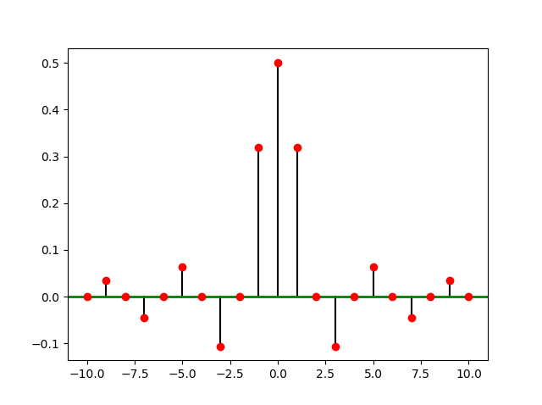
Working out the mechanics
$$a_{k}=\frac{1}{2}sinc(kπ/2)$$
where $sinc(θ)=\frac{sinθ}{θ}$

Slide 26
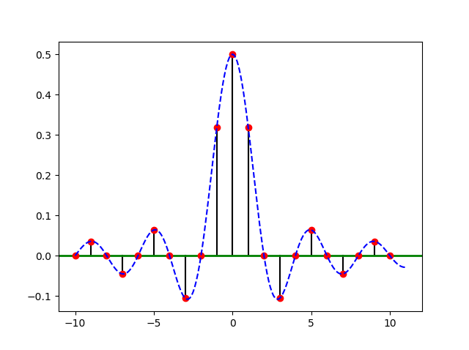
Working out the mechanics
$$a_{k}=\frac{1}{2}sinc(kπ/2)$$
where $sinc(θ)=\frac{sinθ}{θ}$

Slide 27
Question
$$x\left(t\right)=\left\{\begin{aligned}1 \left|t\right|<T1 \\ 0 T1<\left|t\right|≤T\end{aligned}\right.$$
-T₁
T₁
-T/2 0 T/2
How many of the following statements are correct?
1. $ak$ are real and even  | 2. $ak$ are imaginary and odd 
3. $ak$ is 0 if $k$ is even but not zero and duty cycle is 50%  | 4. $ak$ decreases as $k$ increases 

